Slide 1
The RChain Blockchain Structure
Kent Shikama & Michael Birch

Slide 2
Outline
Rholang Recap
RChain state as a Rholang term
Interacting with the RChain state
“Blessed” contracts
Rev
Registry
PoS
The structure of blocks and the DAG
CBC Casper for RChain
Summary

Slide 3
Quick Recap of Rholang
All computation done by processes communicating over names
Types of processes:
Concurrent composition: P | Q
Receive: for(y <- x){ P }
Send: x!(P)
New unforgeable name: new x in { P }
Names are quoted processes; they can be “public” or “unforgeable”
Unforgeable names cannot be referenced outside of their “lexical scope”
E.g. new x in { x!(“Hello, world!”) } | … //no `x` allowed out here!
An unforgeable name can be explicitly shared via a send
Contract definitions just create a “replicated” receive
Send composed with matching Receive reduces via a “comm. event”

Slide 4
RChain is just one big Rholang term**
Everything that exists on-chain will be part of the term
Block = past state + current state + diff
But more on that later
** Each namespace is actually its own term, so RChain is really a collection of Rholang terms

Slide 5
Interacting with the RChain state
“Deploy” operation -- add code to the blockchain
Deploy(P, wallet details, phlogiston/rev conversion rate)
S → S | P
More information on payment details in the next talk!
More information on tokens/purses/wallets coming later!
P can be essentially any valid Rholang code
However, the blockchain runtime environment will differ from today’s interpreter in some important ways
allows it to be used safely by multiple users
E.g. read/write restrictions on some public name channels
Note: unforgeable names are not directly accessible from off-chain

Slide 6
“Blessed” Contracts
Exist from genesis
Perform system-critical tasks
Rev Minting
Contract registration
Proof-of-Stake
“Blessed” means no user created them and no one needs to pay for their storage -- they will be on-chain forever

Slide 7
The Rev Contract
Core ideas:
A “mint” has the authority to produce new, non-empty “purses”
Purses have the authority to
Produce new, empty purses
Accept deposits from other purses of the same mint
Authorities are managed via unforgeable names
The Rev contract is a particular mint that exists at genesis
Its authority will be protected by business logic as given by the RChain Coop
Code available:
https://github.com/rchain/rchain/blob/dev/rholang/examples/linking/v0.2/packages/MakeMint.rho
http://erights.org/elib/capability/ode/ode-capabilities.html

Slide 8
Purses vs. Wallets
Purse = full featured object reference (a near literal bag of coins)
Must always be referenced by unforgeable names only
Wallet = contract-wrapped purse to allow secure access from an off-chain entry point
E.g. a contract accessible from a public name may verify a signature before providing access to the underlying purse reference
Contract-wrapped purses are more general than personal token storage!
Attenuated forwarders (expose limited authority publicly), e.g. a deposit-only facet
Lotteries - participants provide purses to a contract; all tokens dumped into single contract-controlled purse which can be given to the winner
Betting - similar to lotteries, but winner could be determined by an on-chain oracle
Most importantly -- proof-of-stake!

Slide 9
Example: Alice Sends Bob 10 Rev
Alice has an Ethereum-like wallet at the public channel @`0xAliceWalletHash`
Bob has a deposit-only contract at the public channel @`0xBobDepositHash`
Alice deploys the following Rholang code:
new walletCh, bobPaymentCh, successCh in {
@`0xAliceWalletHash`!(nonce, sig, *walletCh) |
for(@result <- walletCh){
match result {
[purse] => {
... //continued on next slide
}
_ => { @”client”!(“Error: nonce/sig not accepted!”) }
}
}
}

Slide 10
Example: Alice Sends Bob 10 Rev Continued...
@purse!(“sprout”, [], *bobPaymentCh) | for(bobPayment <- bobPaymentCh){
bobPayment!(“deposit”, [10, purse], *successCh) |
for(@success <- successCh) {
match success {
true => {
@`0xBobDepositHash`!(*bobPayment, “10 rev from Alice”) |
@”client”!(“Payment send success!”)
}
false => { @”client”!(“Error: Deposit to payment purse failed!”) }
}
}
}

Slide 11
The Registry Contract
Public names are needed for off-chain entry points into RChain
But unregulated public names could be user-unfriendly
Phishing
Unwanted races/intercepting
Blockchain runtime will prohibit sending/receiving on @`rho:...` names
Registry contract allows “unlocking” such public names for use as contracts
Unlocking allows one user to declare a contract on that name and all other users to invoke it
Note certain public names will be unlocked in genesis

Slide 12
The Registry Contract
The registry allows names of the following categories:
Hashes of code body: e.g. `rho:hash:sha256:hash`
requires submitted code to match hash
Public key: e.g. `rho:pubkey:secp256:key`
requires proof of ownership via signature
Externally owned domain names: e.g. `rho:iana:google.com`
requires proof of ownership

Slide 13
Example: Creating and invoking a contract
//this will work, but cannot be accessed from off-chain deploy
new helloWorld in {contract helloWorld(_) = { @”client”!(“Hello, world!”) }}
//this will fail at runtime as @`rho:myCoolContract` is not registered
contract @`rho:myCoolContract`(@x, return) = { return!(2 * x) }
//this will fail at runtime for the same reason
@`rho:myCoolContract`!(2, “client”)

Slide 14
Example: Creating and invoking a contract
//register a new contract by its hash
new codeBodyCh, hashCh, uriCh, resultCh, registered in {
//store contract body in variable
codeBodyCh!({ return!(2 * x) }) |
for(@codeBody <- codeBodyCh) {
//compute hash
@`rho:crypto:sha256`!(codeBody, *hashCh) | for(@hash <- hashCh) {
//create valid, available URI
@`rho:uri:concat`(`rho:hash:sha256:`, hash, uriCh) |
... //continued on next slide
}
}
}

Slide 15
Example: Creating and invoking a contract
for(@uri <- uriCh) {
//register the URI
@`rho:register`!(“hash:sha256”, [uri, codyBody], *resultCh) |
for(@result <- resultCh) {
match result {
//if the registration was successful we get a name for our contract
[contractName, true] => {
contract @contractName(@x, return) = { codeBody } |
registered!(true)
}
[err, false] => { @”client”!(err) }
}
} |
for(_ <- registered){ @uri!(2, “client”) } //can now call contract!
}

Slide 16
Example: Creating and invoking a contract
Notes:
@contractName is a private name with the privilege to listen on the URI we gave
The runtime environment automatically converts our contract statement into one which is listening on the public URI
This allows the call we make at the end of the example, as well as calls made directly in future deploys to the blockchain

Slide 17
The PoS Contract
Handles bonding, unbonding, slashing and rewards distribution
The bonds are used as weights in the CBC Casper consensus protocol
(More on that later)
Unbonding provides a mechanism for validator rotation
Rotation is incentivised by validators not being rewarded until after unbonding
Slashing incentivizes protocol-following behaviour
For more details see:
https://rchain.atlassian.net/wiki/spaces/CORE/pages/346849284/Details+of+Proof-of-Stake+in+RChain

Slide 18
The PoS Contract
Much of this is a tentative spec and subject to change
The PoS contract has the following properties set**:
Maximum number of “active” validators
Maximum number of “queued” validators
Maximum unbonding rate
Post-unbonding stake holding time
Minimum bond amount
Maximum bond amount
Cryptographically verifiable requirements for validating
**Actually, each “region” has these properties and the PoS contract knows all of them

Slide 19
The Bonding Process
User calls the PoS contract with
A form of cryptographic identification (e.g. a public key)
A purse (containing their bond)
Cryptographic evidence showing they meet the validator requirements
Bond is successful if:
Purse contains a proper number of tokens
Evidence is valid
Validator is immediately active if there is an open spot
Otherwise they are queued

Slide 20
The Unbonding Process
Validator calls the PoS contract with
Their signature
A return channel
Unbond is successful if
The signature is valid
This unbond would not cause the maximum rate to be exceeded
If there are queued validators
One randomly becomes active
An unbonded validator is inactive
But still can be slashed until they receive their stake back

Slide 21
Slashing
Offending validator loses (a portion of) their stake
Requires cryptographic evidence of the offence
Any validator can slash any other validator
Accuser calls PoS contract with
ID of offender
Signature of accurser
Evidence of the offence
Slashable offences include:
Equivocation (as per CBC Casper)
Creating an invalid block
Failing to meet the validator performance requirements

Slide 22
Getting Paid (i.e. validator rewards)
An ex-validator can call the PoS contract** with
Their ID used while validating
Signature
Return channel
If ID/signature check out
the rewards are sent in a purse via the return channel
**Actually, a local PoS contract for each namespace will track rewards and that is what the ex-validator will need to call

Slide 23
Block Structure

Slide 24
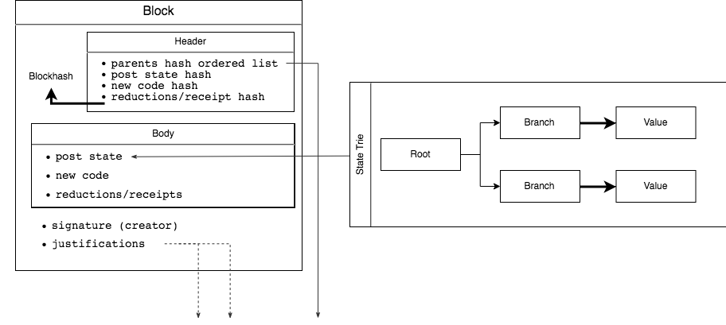

Slide 25
CBC Casper for RChain

Slide 26
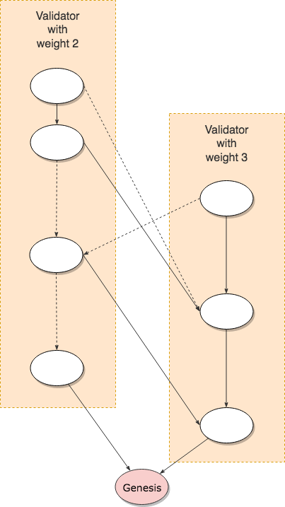
(Inclusive) GHOST traversal
Scoring (Start stage)

Slide 27
GHOST traversal
Scoring (First step for each validator)

Slide 28
GHOST traversal
Scoring (Remaining Steps)

Slide 29
GHOST traversal
Forkchoice

Slide 30
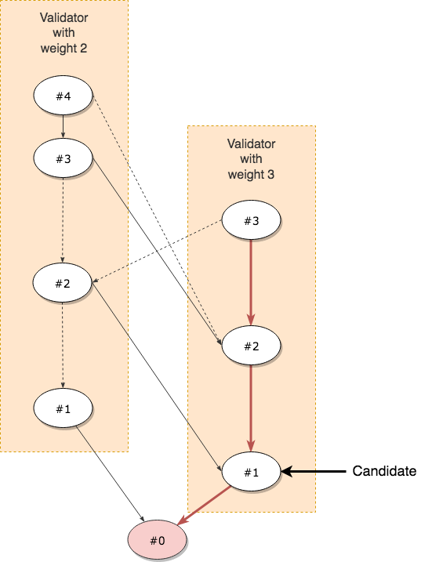
Finalizing blocks
Choosing a candidate

Slide 31
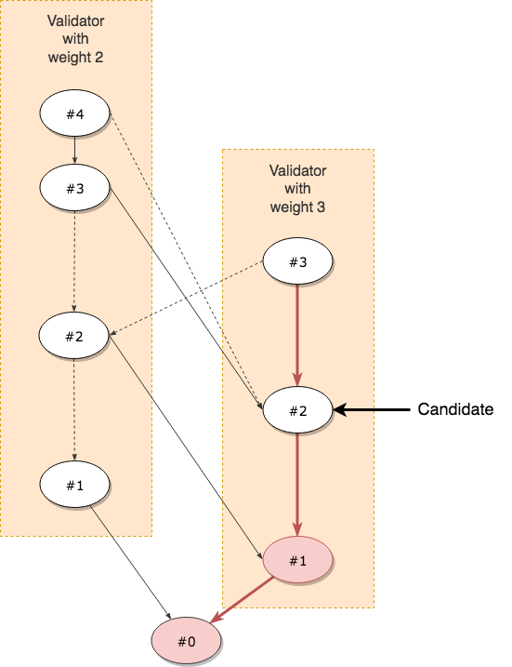
Finalizing blocks
The next candidate

Slide 32
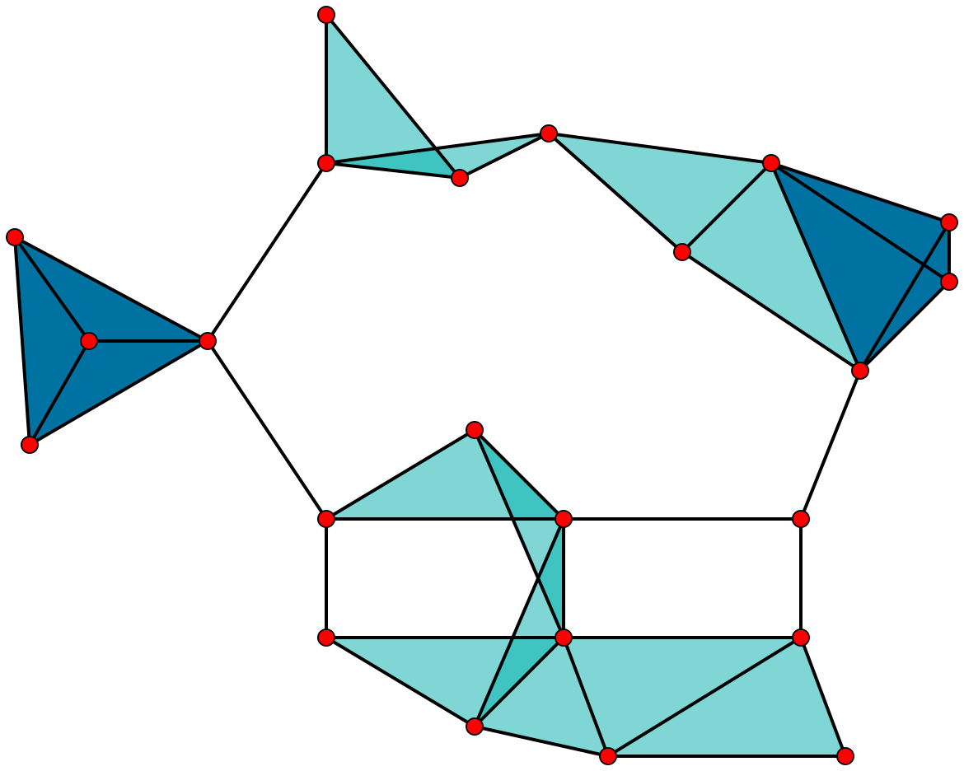
Clique Oracle
Finding a clique
Source: Wikipedia Clique (David Eppstein)

Slide 33
Finalizing blocks
Revisited

Slide 34
Finalizing blocks
Agreement Graph

Slide 35
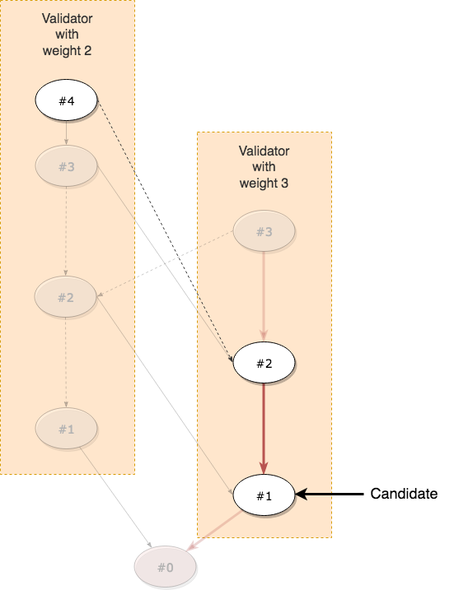
Finalizing blocks
Validator with weight 2 sees validator with weight 3 agreeing with Candidate

Slide 36
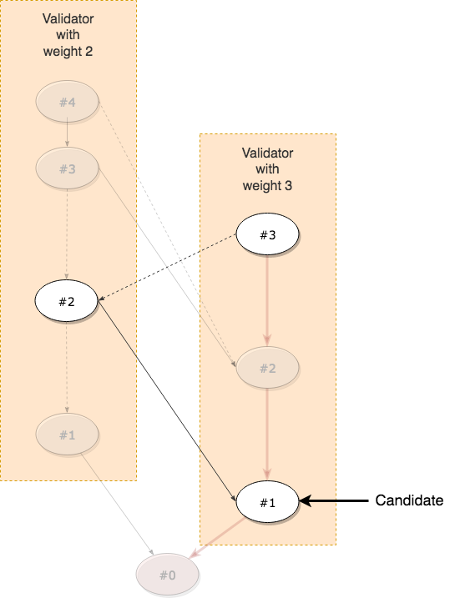
Finalizing blocks
Validator with weight 3 sees validator with weight 2 agreeing with Candidate

Slide 37
Finalizing blocks
Validator with weight 2 will never eventually see validator with weight 3 disagreeing with Candidate

Slide 38
Finalizing blocks
Validator with weight 3 will never eventually see validator with weight 2 disagreeing with Candidate

Slide 39
Finalizing blocks
Maximum clique is 100% of total weight

Slide 40
Finalizing blocks
#1 is safe and we move on

Slide 41
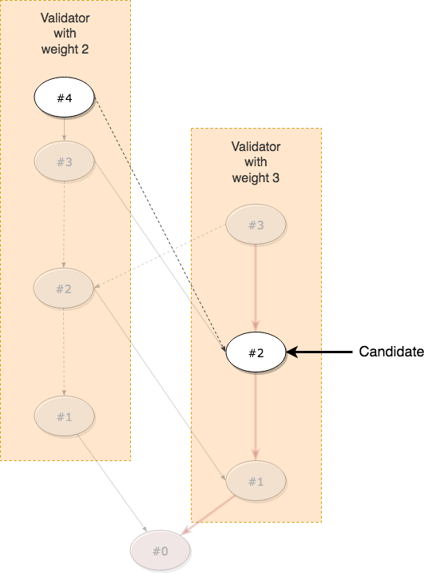
Finalizing blocks
Validator with weight 2 sees validator with weight 3 agreeing with new Candidate

Slide 42
Finalizing blocks
Validator with weight 3 does NOT see validator with weight 2 agreeing with new Candidate

Slide 43
Finalizing blocks
Maximum clique is 60% (⅗) of total weight

Slide 44
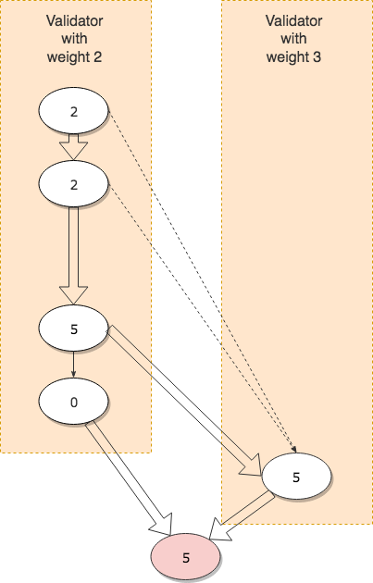
GHOST traversal
With multiple parents

Slide 45
Summary
The RChain state can be thought of as a large Rholang term
Outside users interact with this state by “parring-in” valid Rholang code
Special contracts exist at genesis to support important functionalities
Rev minting
Contract registration
Proof-of-stake
Blocks contain:
Reference to parent(s); multiple parents must not conflict
Hash of the current state
New code added to the state since the parent block(s)
Comm. events since the parent block(s)
The consensus protocol follows the CBC Casper framework

